Slide 1

Sensor Kit (Kit 1)
ZAS Robotics Training

Slide 2



Sensor Kit - Contents
Sensor Kit Components
Sensor Creative Board

Slide 3




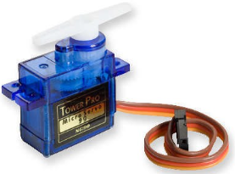
SFL06: SERVO MOTOR CONTROL
Things Needed

Slide 4
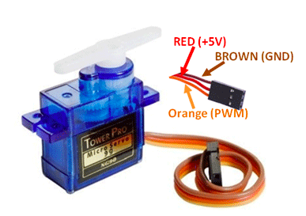
SFL06: SERVO MOTOR CONTROL
Servo motor

Slide 5
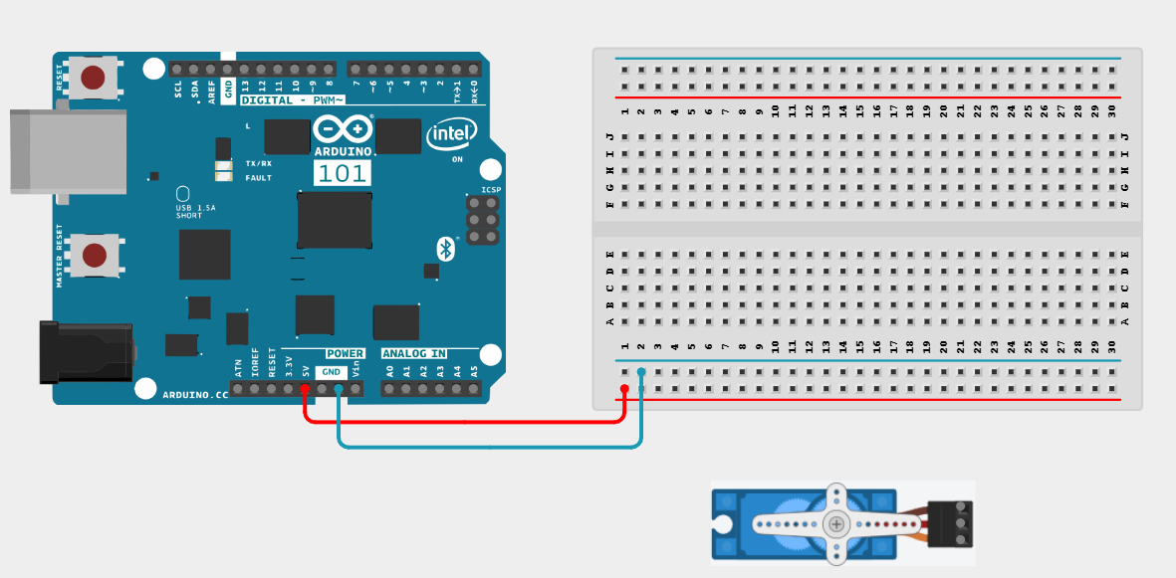
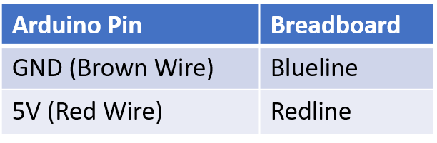
SFL06: SERVO MOTOR CONTROL
Connections:

Slide 6

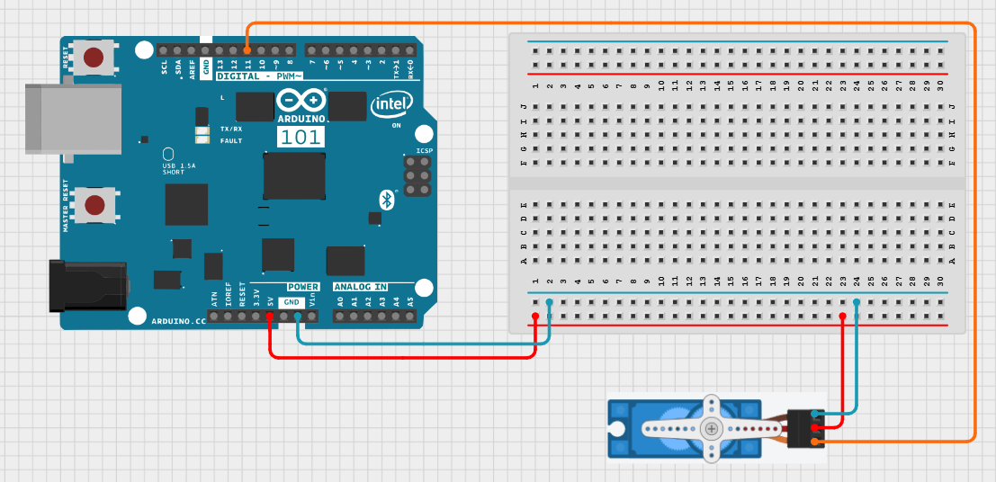
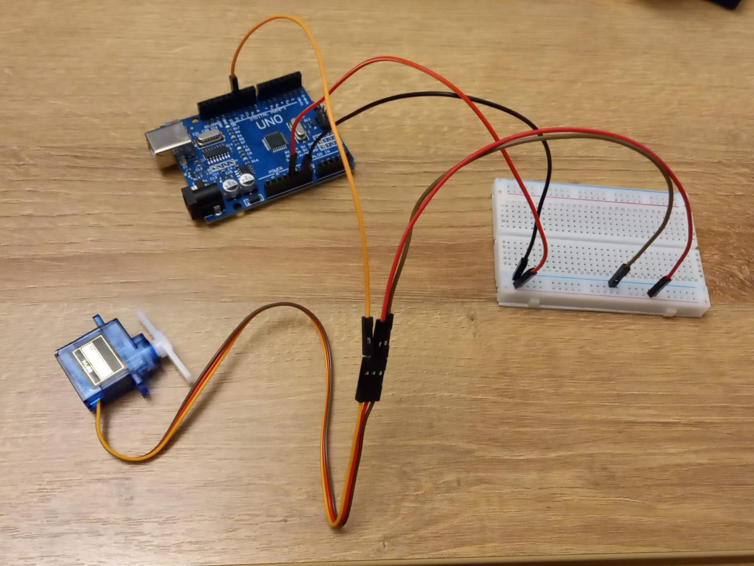
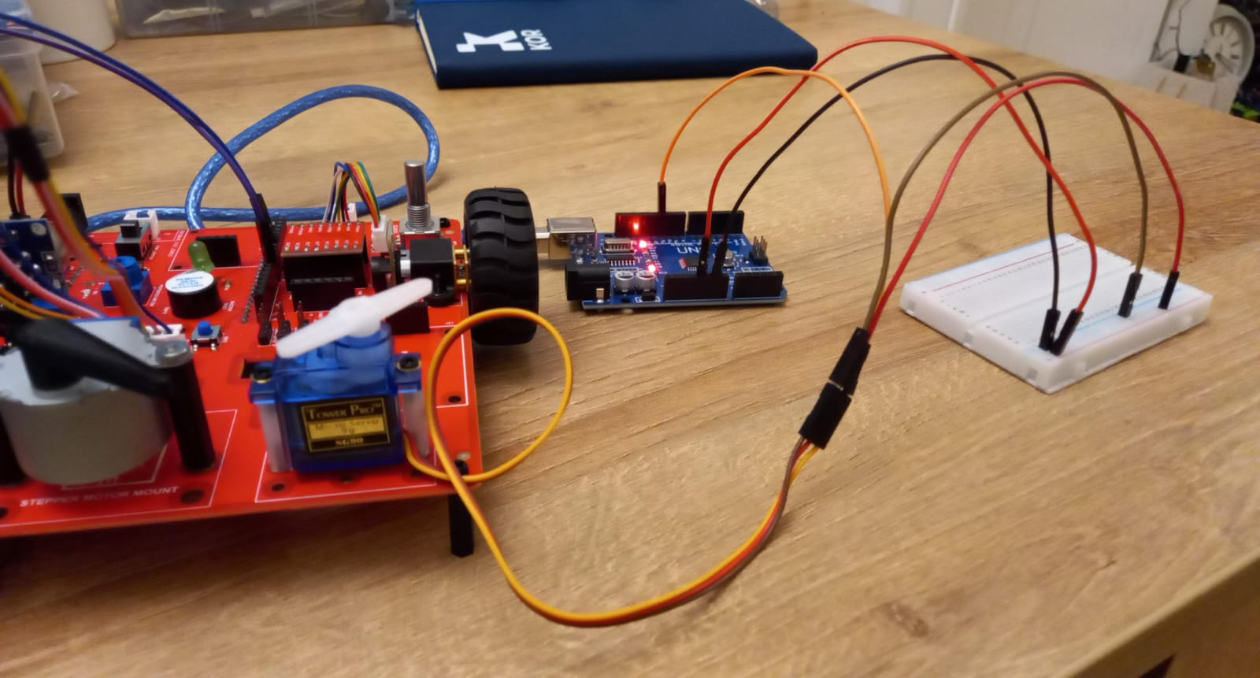
SFL06: SERVO MOTOR CONTROL
Connections:
Servo Pin | Arduino Pin
PWM (Orange Wire) | 11
GND (Brown Wire) | GND (Breadboard)
5V (Red Wire) | 5V (Breadboard)

Slide 7
SFL06: SERVO MOTOR CONTROL
Include the servo library
setup()
• attach servo to pin 11
loop()
• Move the servo from 0 to 180 degrees in steps of 10 degrees
• Move the servo back from 180 to 0 degrees in steps of 10 degrees
Code for Lesson SFL06:
https://github.com/info-zas/zas-robotics-sensors/blob/main/01_FoundationProjects/01_Code/_06_ControllingServoMotor/_06_ControllingServoMotor.ino

Slide 8
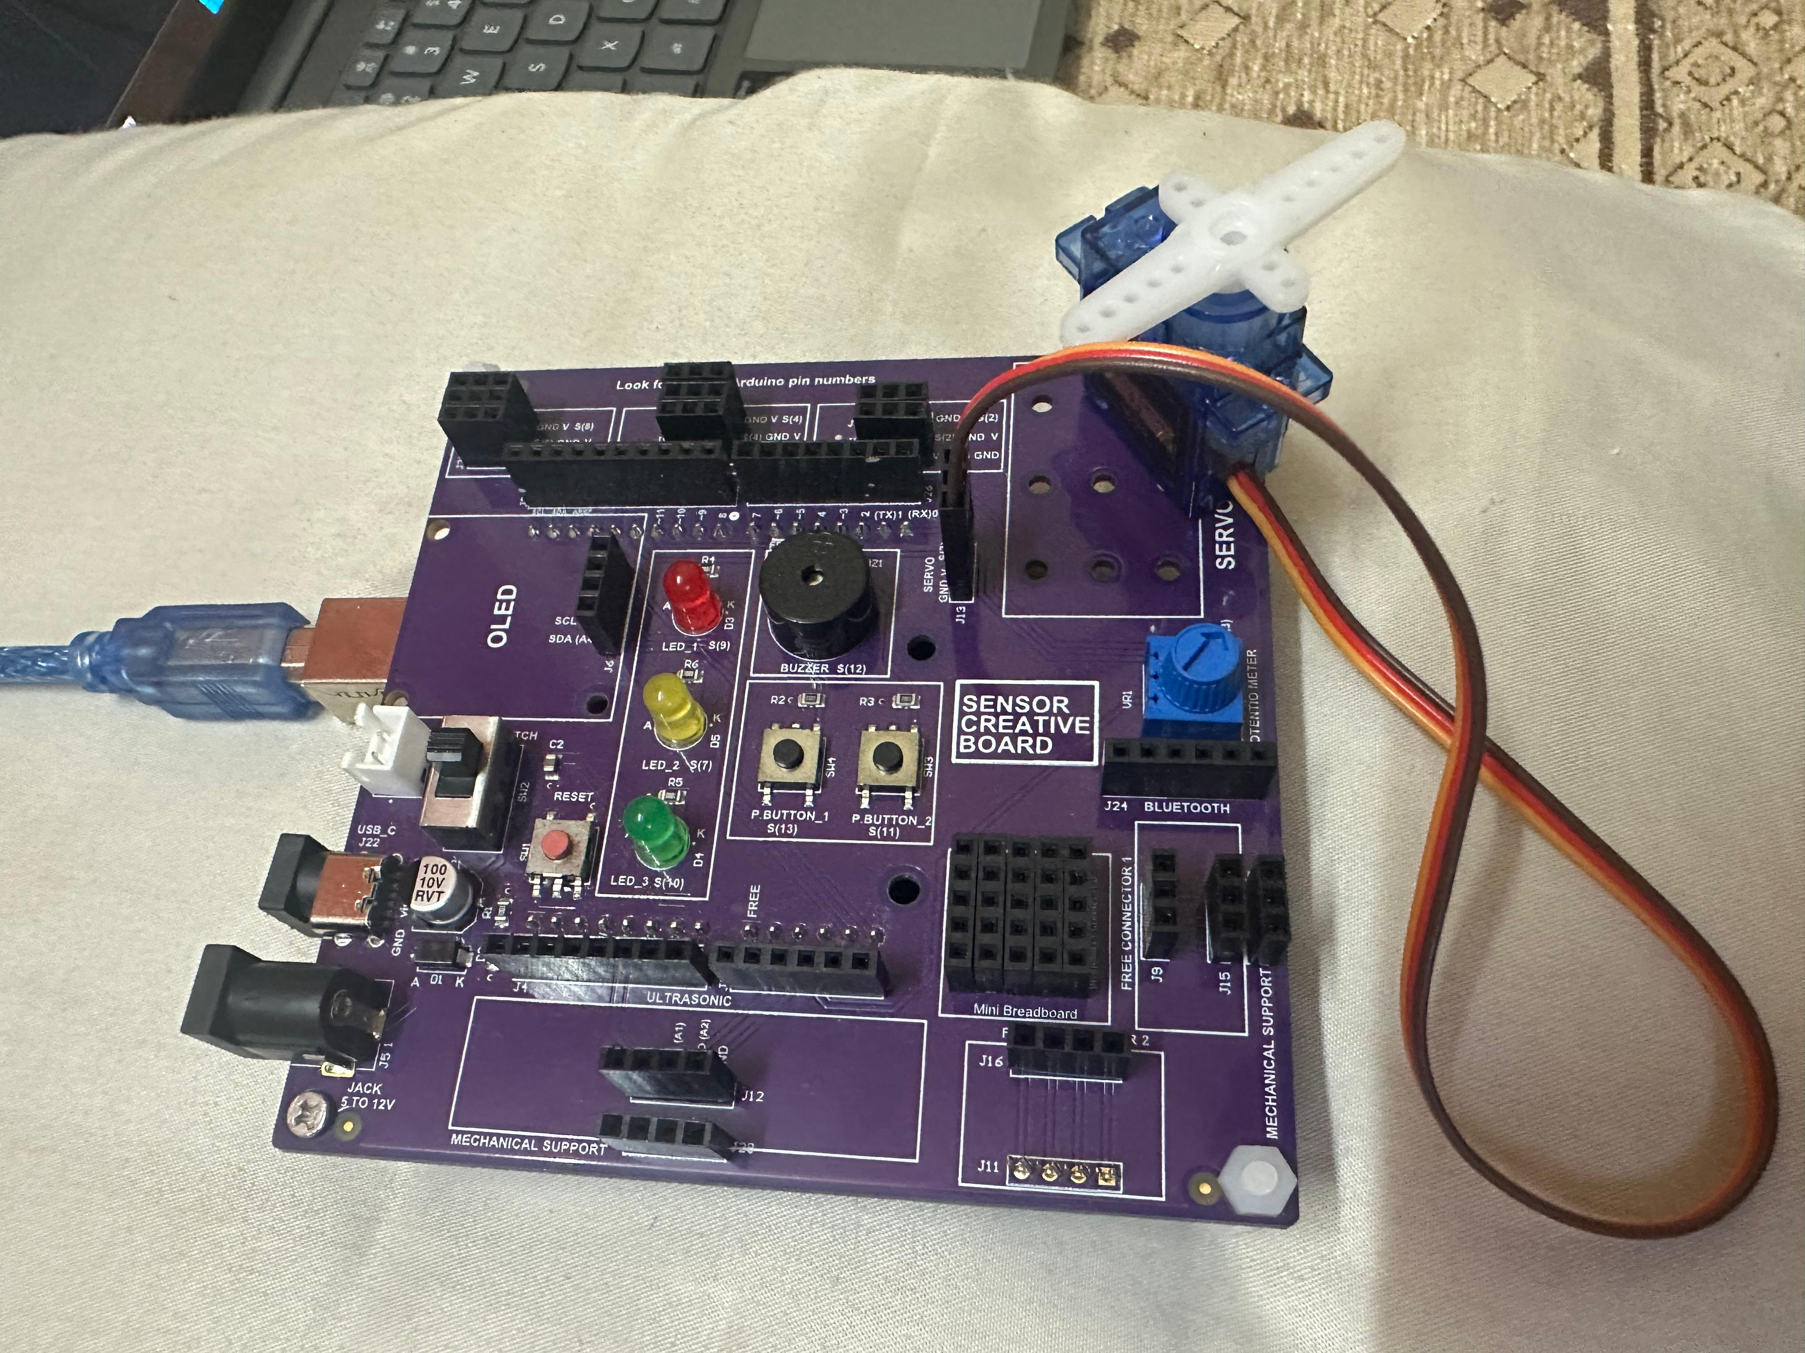
SFL06: SERVO MOTOR CONTROL
A dedicated slot is provided for connecting a servo motor.
The slot plugs directly into the microcontroller — no wiring needed.
Makes servo connection simple, quick, and error-free.
Helps students analyse and test servo movement easily.
Supports experimenting by combining the servo with different sensors.
Great for learning motor control in a beginner-friendly way.

Slide 9
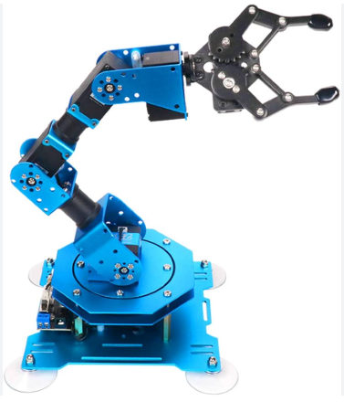
Applications of Servo Motors
Applications of Servo Motors
Robotics: Robot arms, pick-and-place systems
Industrial Automation: CNC machines, conveyor control
Electronics Projects: Arduino-based motion control
Automotive Systems: Power steering, headlamp positioning
Medical Equipment: Surgical robots, prosthetic limbs
Consumer Products: Remote-controlled toys, drones
Servo motors are used wherever precise position and motion control is required.

